Slide 1
Disk scheduling
Disk scheduling is a technique operating systems use to manage the order in which disk I/O (input/output) requests are processed. Disk scheduling is also known as I/O Scheduling. The main goals of disk scheduling are to optimize the performance of disk operations, reduce the time it takes to access data and improve overall system efficiency.

Slide 2
Disk scheduling
Disk scheduling algorithms are crucial in managing how data is read from and written to a computer’s hard disk.
These algorithms help determine the order in which disk read and write requests are processed, significantly impacting the speed and efficiency of data access.
Common disk scheduling methods include First-Come First-Served (FCFS), Shortest Seek Time First (SSTF), SCAN, C-SCAN, LOOK, and C-LOOK.

Slide 3
Disk Scheduling
The operating system is responsible for using hardware efficiently — for the disk drives, this means having a fast access time and disk bandwidth.
Access time has two major components
Seek time is the time to move the heads to the cylinder containing the desired sector.
Rotational latency is the additional time waiting for the disk to rotate the desired sector to the disk head.
Minimize seek time
Seek time ≈ seek distance
Disk bandwidth is the total number of bytes transferred, divided by the total time between the first request for service and the completion of the last transfer.

Slide 4
Importance of Disk Scheduling
Multiple I/O requests may arrive by different processes and only one I/O request can be served at a time by the disk controller. Thus other I/O requests need to wait in the waiting queue and need to be scheduled.
Two or more requests may be far from each other so this can result in greater disk arm movement.
Hard drives are one of the slowest parts of the computer system and thus need to be accessed in an efficient manner.

Slide 5
Key Terms Associated with Disk Scheduling
Seek Time: Seek time is the time taken to locate the disk arm to a specified track where the data is to be read or written. So the disk scheduling algorithm that gives a minimum average seek time is better.
Rotational Latency: Rotational Latency is the time taken by the desired sector of the disk to rotate into a position so that it can access the read/write heads. So the disk scheduling algorithm that gives minimum rotational latency is better.
Transfer Time: Transfer time is the time to transfer the data. It depends on the rotating speed of the disk and the number of bytes to be transferred.
Disk Access Time:
Disk Access Time = Seek Time + Rotational Latency + Transfer Time
Total Seek Time = Total head Movement * Seek Time

Slide 6
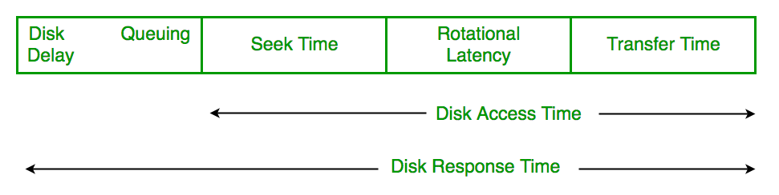
Disk Response Time: Response Time is the average time spent by a request waiting to perform its I/O operation. The average Response time is the response time of all requests. Variance Response Time is the measure of how individual requests are serviced with respect to average response time. So the disk scheduling algorithm that gives minimum variance response time is better.

Slide 7
Goal of Disk Scheduling Algorithms
Minimize Seek Time
Maximize Throughput
Minimize Latency
Fairness
Efficiency in Resource Utilization

Slide 8
Disk Scheduling Algorithms
FCFS (First Come First Serve)
SSTF (Shortest Seek Time First)
SCAN
C-SCAN
LOOK
C-LOOK
LIFO (Last-In First-Out)

Slide 9
FCFS
FCFS is the simplest of all Disk Scheduling Algorithms.
In FCFS, the requests are addressed in the order they arrive in the disk queue.
Let us understand this with the help of an example.
Suppose the order of request is-(82,170,43,140,24,16,190) And current position of Read/Write head is: 50

Slide 10
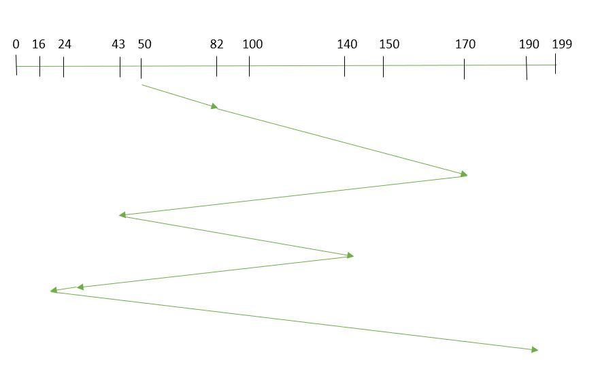

Slide 11
So, total overhead movement (total distance covered by the disk arm) =
(82-50)+(170-82)+(170-43)+(140-43)+(140-24)+(24-16)+(190-16) =642

Slide 12
Advantages of FCFS
Every request gets a fair chance
No indefinite postponement
Disadvantages of FCFS
Disadvantages of First Come First Serve.
Does not try to optimize seek time
May not provide the best possible service

Slide 13
Shortest Seek Time First
In SSTF (Shortest Seek Time First), requests having the shortest seek time are executed first.
So, the seek time of every request is calculated in advance in the queue and then they are scheduled according to their calculated seek time.
As a result, the request near the disk arm will get executed first.
SSTF is certainly an improvement over FCFS as it decreases the average response time and increases the throughput of the system.

Slide 14
SSTF
Selects the request with the minimum seek time from the current head position.
SSTF scheduling is a form of SJF scheduling; may cause starvation of some requests.
Illustration shows total head movement of 236 cylinders.

Slide 15
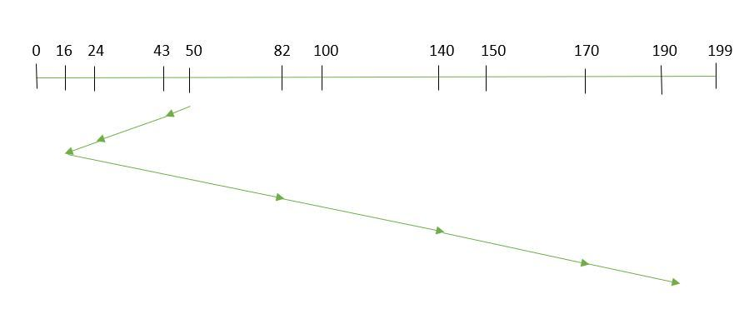
SSTF (Cont.)

Slide 16
Suppose the order of request is- (82,170,43,140,24,16,190) And current position of Read/Write head is: 50
Total overhead movement (total distance covered by the disk arm) =
(50-43)+(43-24)+(24-16)+(82-16)+(140-82) +(170-140)+(190-170) =208

Slide 17
Advantages of Shortest Seek Time First
The average Response Time decreases
Throughput increases
Disadvantages of Shortest Seek Time First
Disadvantages of Shortest Seek Time First
Overhead to calculate seek time in advance
Can cause Starvation for a request if it has a higher seek time as compared to incoming requests
The high variance of response time as SSTF favors only some requests

Slide 18
SCAN
The disk arm starts at one end of the disk, and moves toward the other end, servicing requests until it gets to the other end of the disk, where the head movement is reversed and servicing continues.
Sometimes called the elevator algorithm.
Illustration shows total head movement of 208 cylinders.

Slide 19
In the SCAN algorithm the disk arm moves in a particular direction and services the requests coming in its path and after reaching the end of the disk, it reverses its direction and again services the request arriving in its path.
So, this algorithm works as an elevator and is hence also known as an elevator algorithm.
As a result, the requests at the midrange are serviced more and those arriving behind the disk arm will have to wait.

Slide 20
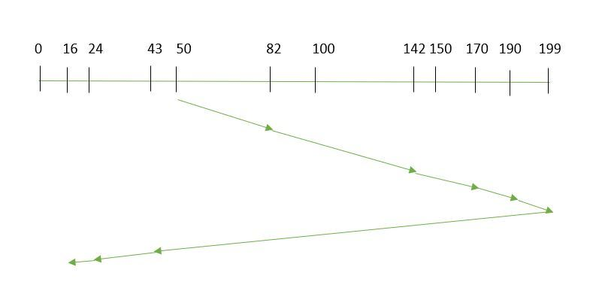
SCAN

Slide 21
82,170,43,140,24,16,190. And the Read/Write arm is at 50, and it is also given that the disk arm should move “towards the larger value”.
Therefore, the total overhead movement (total distance covered by the disk arm) is calculated as
= (199-50) + (199-16) = 332

Slide 22
Advantages of SCAN Algorithm
High throughput
Low variance of response time
Average response time
Disadvantages of SCAN Algorithm
Disadvantages
Long waiting time for requests for locations just visited by disk arm

Slide 23
C-SCAN
In the SCAN algorithm, the disk arm again scans the path that has been scanned, after reversing its direction.
So, it may be possible that too many requests are waiting at the other end or there may be zero or few requests pending at the scanned area.
These situations are avoided in the CSCAN algorithm in which the disk arm instead of reversing its direction goes to the other end of the disk and starts servicing the requests from there.
So, the disk arm moves in a circular fashion and this algorithm is also similar to the SCAN algorithm hence it is known as C-SCAN (Circular SCAN).

Slide 24
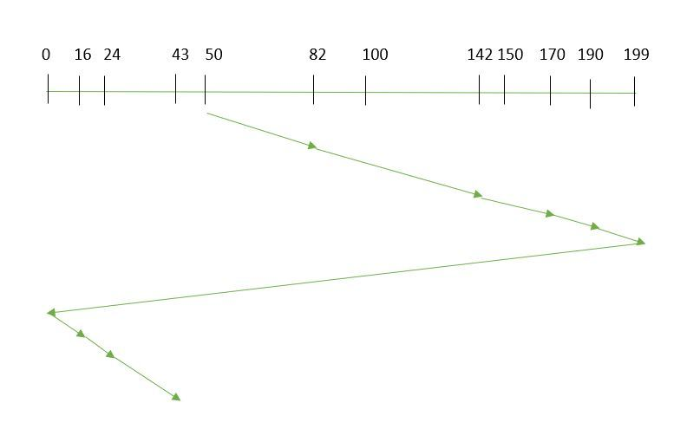
C-SCAN

Slide 25
C-SCAN
Suppose the requests to be addressed are-82,170,43,140,24,16,190.
And the Read/Write arm is at 50, and it is also given that the disk arm should move “towards the larger value”.
So, the total overhead movement (total distance covered by the disk arm) is calculated as:
=(199-50) + (199-0) + (43-0) = 391

Slide 26
Advantages of C-SCAN Algorithm
Here are some of the advantages of C-SCAN.
Provides more uniform wait time compared to SCAN.

Slide 27
LOOK
LOOK Algorithm is similar to the SCAN disk scheduling algorithm except for the difference that the disk arm in spite of going to the end of the disk goes only to the last request to be serviced in front of the head and then reverses its direction from there only.
Thus it prevents the extra delay which occurred due to unnecessary traversal to the end of the disk.

Slide 28
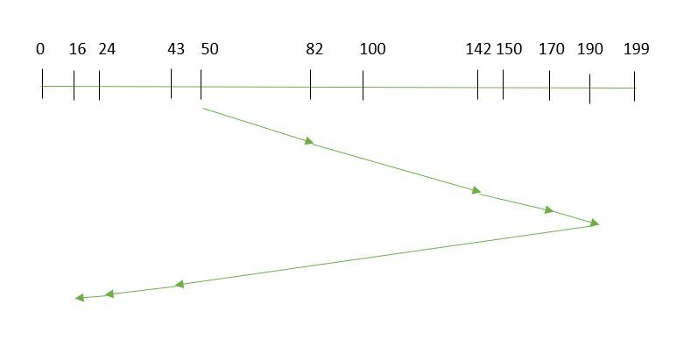
LOOK

Slide 29
Suppose the requests to be addressed are-82,170,43,140,24,16,190. And the Read/Write arm is at 50, and it is also given that the disk arm should move “towards the larger value”.
So, the total overhead movement (total distance covered by the disk arm) is calculated as:
= (190-50) + (190-16) = 314

Slide 30
C-LOOK
As LOOK is similar to the SCAN algorithm, in a similar way, C-LOOK is similar to the CSCAN disk scheduling algorithm.
In CLOOK, the disk arm in spite of going to the end goes only to the last request to be serviced in front of the head and then from there goes to the other end’s last request.
Thus, it also prevents the extra delay which occurred due to unnecessary traversal to the end of the disk.

Slide 31
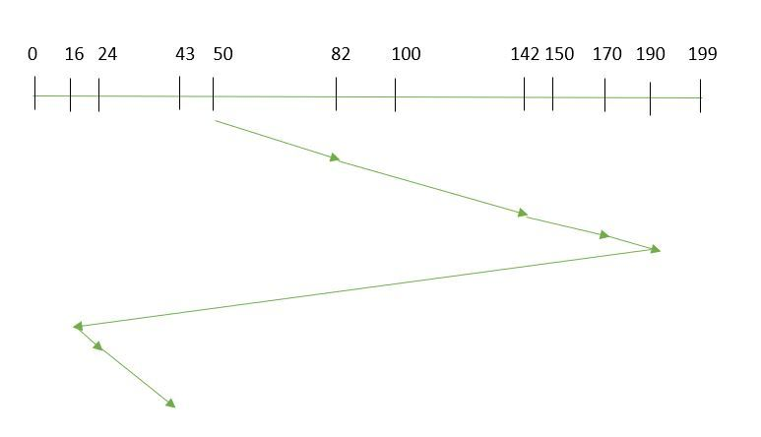

Slide 32
So, the total overhead movement (total distance covered by the disk arm) is calculated as
= (190-50) + (190-16) + (43-16) = 341

Slide 33
LIFO (Last-In First-Out)
In LIFO (Last In, First Out) algorithm, the newest jobs are serviced before the existing ones i.e. in order of requests that get serviced the job that is newest or last entered is serviced first, and then the rest in the same order.

Slide 34
Advantages of LIFO (Last-In First-Out)
Maximizes locality and resource utilization
Can seem a little unfair to other requests and if new requests keep coming in, it cause starvation to the old and existing ones.

Slide 35
Selecting a Disk-Scheduling Algorithm
SSTF is common and has a natural appeal
SCAN and C-SCAN perform better for systems that place a heavy load on the disk.
Performance depends on the number and types of requests.
Requests for disk service can be influenced by the file-allocation method.
The disk-scheduling algorithm should be written as a separate module of the operating system, allowing it to be replaced with a different algorithm if necessary.
Either SSTF or LOOK is a reasonable choice for the default algorithm.

